Slide 1
Solubility
Ch. 16.1

Slide 2
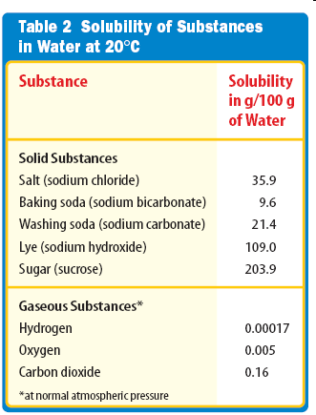
What is solubility?
Solubility – the maximum amount of a solute that can be dissolved in a given amount of solvent at a given temp
Often expressed in g solute/100 g solvent

Slide 3
Miscible vs. Immiscible
Miscible: liquids that dissolve into each other in all proportions
Ex: ethanol in water, ethylene glycol in water
Both liquids are polar or both are nonpolar (like dissolves like)
Immiscible: liquids that are insoluble in each other
Ex: water and oil

Slide 4
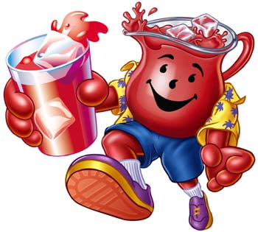
What are the classification of solutions?
Unsaturated Solution
– solution that can dissolve more
solute at a given temp
Saturated Solution - solution that contains all the solute it can hold at a given temp
Super Saturated Solution – solution that contains more solute than a saturated one at the same temp

Slide 5
