Slide 1
The Path to Life as We Know It
Evolution and Biodiversity

Slide 2
Earth: The “Goldilocks” Planet
Temperature
Distance from Sun
Geothermal energy from core
Temperature fluctuated only 10-20ºC over 3.7 billion years despite 30-40% increase in solar output
Water exists in 3 phases
Right size (=gravitational mass to keep atmosphere)
Resilient and adaptive
Each species here today represents a long chain of evolution and each plays a role in its respective ecosystem

Slide 3
Early Earth
Primordial Soup = Life began in a pond/ocean (water environment)
Chemicals in the atmosphere combined with chemicals in the water (along with an energy source) to produce amino acids
Amino acids combined to make proteins
Proteins led to the rise of organisms (unicellular)
Oparin and Haldane (suggested)
Miller and Urey (experiment)

Slide 4
Origins of Life on Earth 4.7-4.8 Billion Year History
Evidence from chemical analysis and measurements of radioactive elements in primitive rocks and fossils.
Life developed over two main phases:
Chemical evolution (took about 1 billion years)
Organic molecules, proteins, polymers, and chemical reactions to form first “protocells”
Biological evolution (3.7 billion years)
From single celled prokaryotic bacteria to eukaryotic creatures to eukaryotic multicellular organisms (diversification of species)
Endosymbiotic theory: eukaryotic cells arose from living communities formed by prokaryotic organisms (organelles are similar)

Slide 5
Summary of Evolution of Life
Chemical Evolution
(1 billion years)
Formation
of the
earth’s
early
crust and
atmosphere
Small
organic
molecules
form in
the seas
Large
organic
molecules
(biopolymers)
form in
the seas
First
protocells
form in
the seas
Biological Evolution
(3.7 billion years)
Single-cell
prokaryotes
form in
the seas
Single-cell
eukaryotes
form in
the seas
Variety of
multicellular
organisms
form, first
in the seas
and later
on land

Slide 6
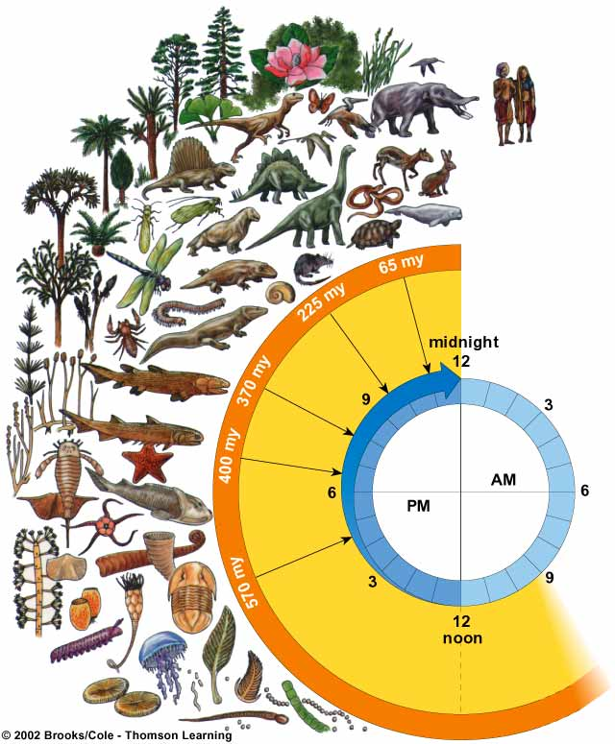
Biological Evolution
Modern humans (Homo sapiens) appear about 2 seconds before midnight
Age of mammals
Recorded human history begins 1/4 second before midnight
Age of reptiles
Insects and amphibians invade the land
Origin of life (3.6–3.8 billion years ago)
Plants invade the land
Fossils become abundant
Fossils present but rare
Evolution and expansion of life

Slide 7
Path to Life
Scientists believe that the Earth’s early atmosphere lacked free oxygen. The first living organisms were anaerobic prokaryotes that resembled chemosynthetic bacteria.
Anaerobic prokaryotes gave rise to photosynthetic prokaryotes (cyanobacteria).
Photosynthetic prokaryotes gave rise to unicellular eukaryotes
Unicellular eukaryotes gave rise to multicellular eukaryotes

Slide 8
Path to Land
https://www.youtube.com/watch?v=z5NiZL0ZWJM

Slide 9
Adaptations to Life on Land
Plants
Development of spores
Waxy cuticle
Development of vascular system (xylem, phloem)
Stomata
Support cells/rigid structure
Vacuoles!!!

Slide 10
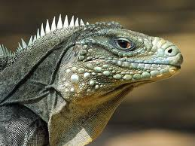
Adaptations to Land
Animals
Eggs/shells
Lungs
Internal fertilization
Thick, scaly skin

